Slide 1
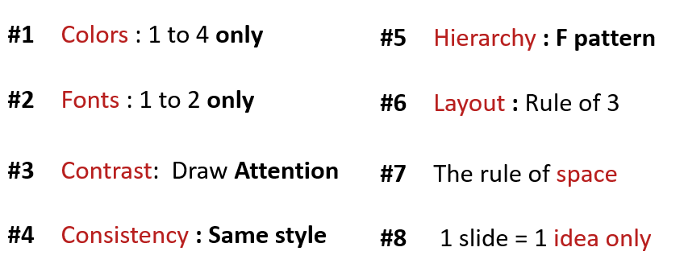
ACTIVITY 1
Analyze the 3 slides
Why they respect the design principle?

Slide 2
Computer / Database Diagram
Marketing is the study and management of exchange relationships. Marketing is the business process of creating relationships with and satisfying customers.
Analyze
Promotions only work as well as the marketing, to get your company’s.
+35
To get your company’s name out there.
Advertise
Promotions only work as well as the marketing, to get your company’s.
+10
To get your company’s name out there.
Identify
Promotions only work as well as the marketing, to get your company’s.

Slide 3
Comparison Chart
Marketing is the study and management of exchange relationships. Marketing is the business process of creating relationships with and satisfying customers.
Develop
Analyze
Promotions only work as well as the marketing. Promotions only work as well as the marketing.
vs.
Promotions only work as well as the marketing. Promotions only work as well as the marketing.
Promotions only work as well as the marketing.
Promotions only work as well as the marketing.
DEVELOP
DEVELOP
ANALYZE
ANALYZE
Promotions only work as well as the marketing.
Promotions only work as well as the marketing.
IDENTIFY
IDENTIFY

Slide 4
Title One
Promotions only work
as well as the marketing.
Title Two
Promotions only work
as well as the marketing.
Business
Infographics
Title Three
Promotions only work
as well as the marketing.
Marketing is the study and management
of exchange relationships.
Title Four
Promotions only work
as well as the marketing.
Title Five
Promotions only work
as well as the marketing.

Slide 5
1. Analyze the 3 slides
For first slide : I think good but it have small font size below tittle.
For second slide : I think good too but it have small font size like frist slide.
For last Slide: I think It use a lots picture but no problem because it relate and the same color.
But all slide have small text on body.
2. Why they respect the design principle?.
Because It make the slide powerful and interesting. It make audience want to know about imformation on the slide.

